Slide 1
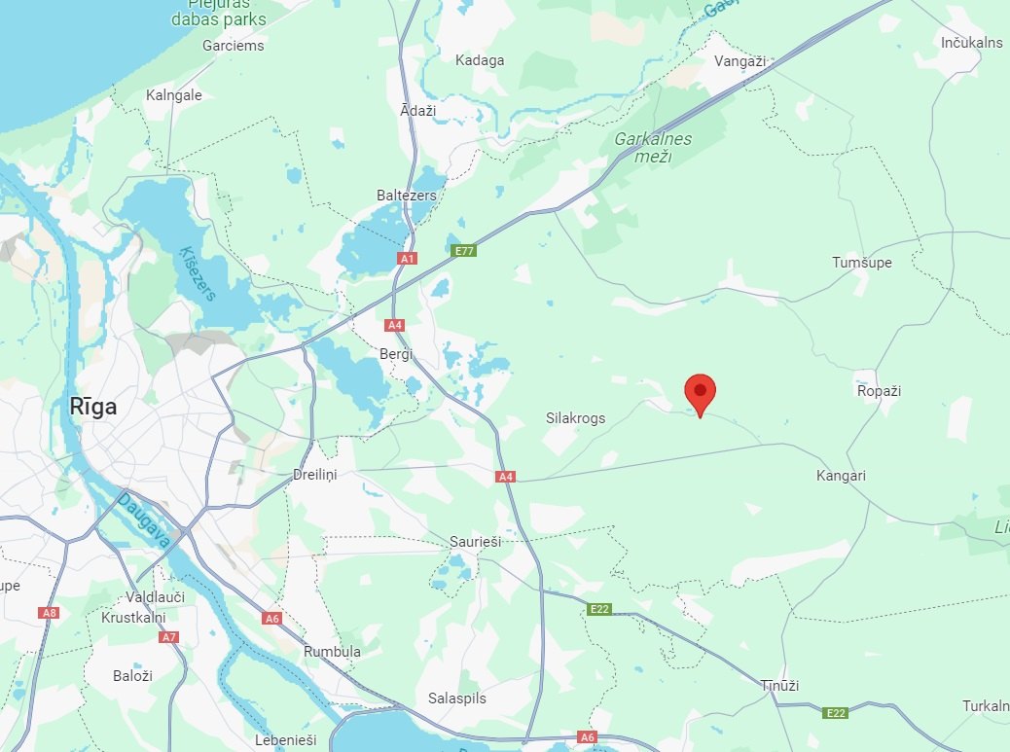
LIQUIDATION OF ROASTING EQUIPMENT ONE – TIME OFFER
Whole equipment price 150`000,- EUR (+ VAT where applicable)
ABOUT THE ASSETS
The offer includes a fully complete coffee roasting, sorting & packaging line.
The equipment on offer is both completely new and slightly used. All equipment is in very good condition.
Roasting, sorting & packaging line capacity: up their 400 kg/h; 3200 kg 1 shift.
THE EQUIPMENT
Coffee beans roasting lines:
* Coffee bean roasting line SR120 (new, 2023), * Coffee bean roasting line SR 25 (2017) * Coffee bean roasting line SR 5 (new, 2023)
Other equipment:
* Photoseparator (2018, Sapsan SE 36 D) * Coffee beans packaging line "Makiz-Kompakt Y-03" (2019) * Packaging equipment for weighing and packaging of ground and bean coffee (2016) * Coffee grinders (2015, 2016)
* BT electric pallet truck (2017) * Hydraulic hand stepper (2018) * Diesel forklift ( 2022)
* Auxiliary equipment
LOCATION
Located in Zakumuiza, Avotini,
Ropazu district, Latvia.
Easy cargo loading.
FOR MORE INFORMATION CONTACT
Agnese Savockina
Consultant
Agnese.savockina@nilsson.lv
+371 28 777 723

Slide 2
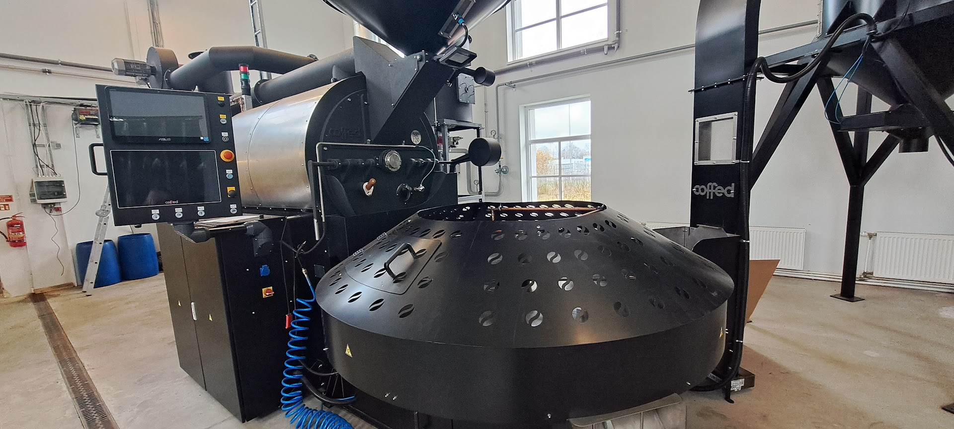
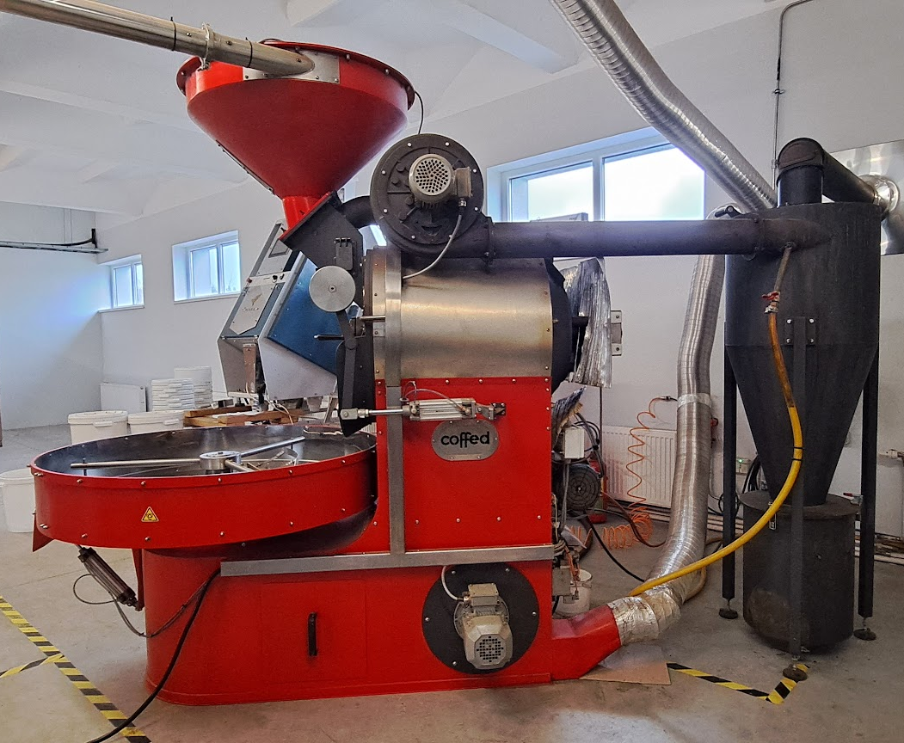
LIQUIDATION OF ROASTING EQUIPMENT ONE – TIME OFFER
TECHNICAL PARAMETERS
Coffee bean roasting line SR120 (Almost new, 2023), comes with LPG tank (x tons) installation if necessary
*Only ca 20 tons roasted
*Batch size: 60-120 kg
*Efficiency up to 480 kg/h
*Roasting time: 10-20 min
*Burner fuel: LPG
*Gas supply pressure: 20-50 mbar
*Power supply: 3x400VAC
*15-inch touch panel
*Stainless steel housing and cast iron parts
*Double wall drum
*Temperature sensors in coffee and exhaust
*Control airflow by flaps allow user recover up to 30% of heat from the drum
*Drum and exhaust gas fan speed control
*Profiles and roasting recipe saving function
Coffee bean roasting line SR 25 (used 2017)
*Batch size: 10-25 kg
*Efficiency up to 88 kg/h
*Roasting time 12-35 min
*Burner fuel: LPG/Natural gas/Biogas
*Gas supply pressure: 20-50 mbar (37 optimally)
*Power supply: 3x400VAC
*15-inch touchscreen
*Double wall drum
*Temperature sensors in coffee and in exhaust gases
*Stainless steel drum cover
*Fully modular burner
*Drum and exhaust gas fan speed control
Price 80`000,- EUR
Price 15`000,- EUR
FOR MORE INFORMATION CONTACT
Agnese Savockina
Consultant
Agnese.savockina@nilsson.lv
+371 28 777 723

Slide 3
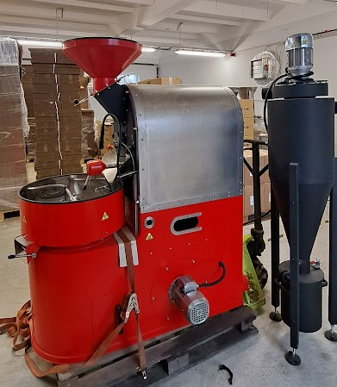
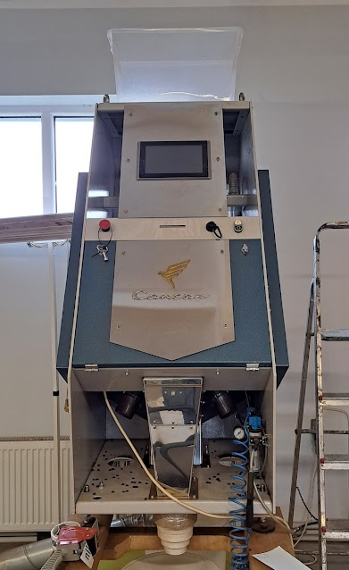
LIQUIDATION OF ROASTING EQUIPMENT ONE – TIME OFFER
TECHNICAL PARAMETERS
Coffee bean roasting line SR 5 (new, 2023)
*Batch size: 2-6 kg
*Efficiency up to 20 kg/h
*Roasting time 8-20 min
*Burner fuel: LPG/Natural gas/Biogas
*Gas supply pressure: 20-50 mbar (37 optimally)
*Power supply: 1x230VAC
*Double wall drum
*Temperature sensors in coffee and in exhaust gases
*Stainless steel housing
*Fully modular burner
*Drum rotation speed control
*Exhaust gas fan speed control
Photoseparator Sapsan SE 36 D (used, 2018)
Block feed product:
*Trays of vibrators from stainless steel;
*1 vibrator;
*1 sliding tray.
Optical-electronic block:
*LED backlight
*2 RGB (color) speed cameras with computing
Blocks on the basis of powerful dual-core processors digital signal processing, with 3 linear sensors of 2128 pixels each, improved color transfer with color formation
digital image with 16,000,000 colors and frequencies
scanning up to 20,000 frames (strok) in seconds;
*Automatic cleaning system with timer.
Block of pneumatic valves:
*36 pneumatic valves «MAC»;
*Block of air conditioning and separator "FESTO".
Price 7`000,- EUR
Price 10`000,- EUR
Control unit:
*Sensor control, TFT LCD, Windows 7.
Construction:
*Stainless steel for working with food
products;
*Powder coating frame;
*Industrial glass, high strength
anti-scratch protection system
FOR MORE INFORMATION CONTACT
Agnese Savockina
Consultant
Agnese.savockina@nilsson.lv
+371 28 777 723

Slide 4
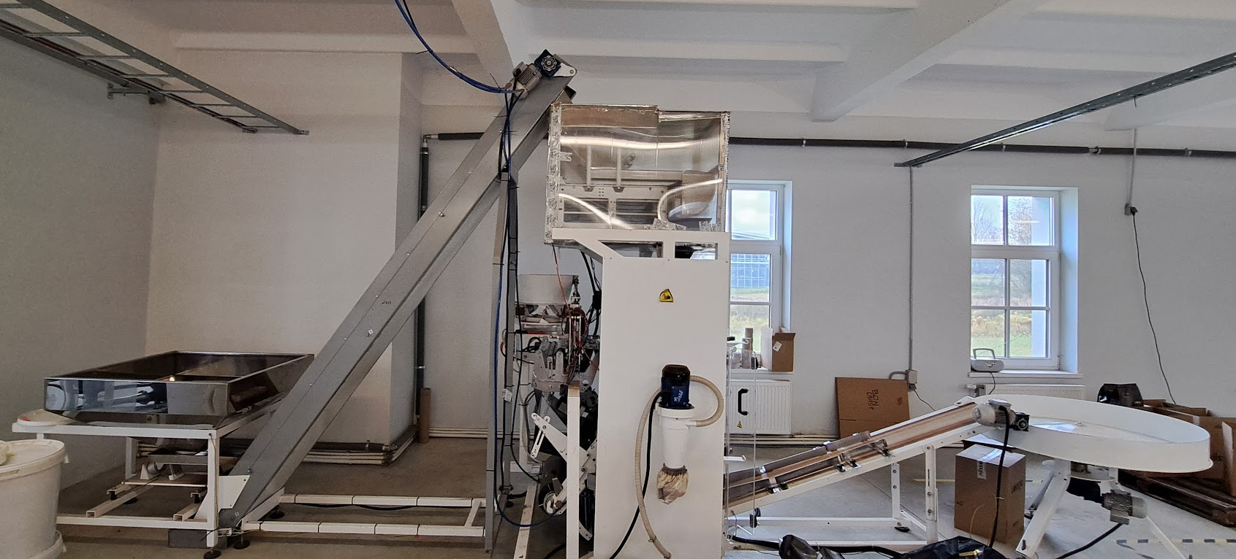
LIQUIDATION OF ROASTING EQUIPMENT ONE – TIME OFFER
TECHNICAL PARAMETERS
Full coffee beans roasting equipment "Makiz-Kompakt Y-03" (used, 2019)
Packaging line with bag former, degassing valve applicator, weighing, nitrogen flushing), additional forming heads available
*"flat bottom" packages
*film correction system
*edge forming unit
*sensor photo tags
*encoder
*film width from 270-560 mm.
*the maximum package is 150x100 mm.
Characteristics:
Productivity - up to 40 packages/min
Performance is specified for single stretch film
*power supply 220 V, 50 GHz;
*power consumption 1.5 kW;
*pneumatic drive, flow rate 400 l/min;
*weight bucket capacity 6.0 l;
Price 15`000,- EUR
FOR MORE INFORMATION CONTACT
Agnese Savockina
Consultant
Agnese.savockina@nilsson.lv
+371 28 777 723

